Slide 1

Project 3:
NLP Reddit Project
Presented by: Daniel | Peter | Supriya | Wei Hua
Notes:
Good morning Friends!
Today our team (Daniel,Peter,Supriya and I) will be presenting on the Project 3 - NLP Reddit project

Slide 2
Problem statement
Who’s the Client?
Marvel DC United specialising in video games
Who are we?
Data scientists from a consultancy firm
Task:
Classify Marvel and DC fans on reddit for targeted advertising of the client’s new superhero game
Identify and recommend most discussed heroes to be included in the game

Slide 3
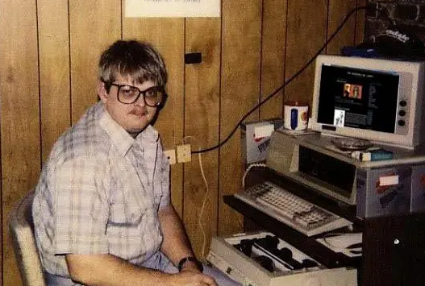

StakeholderS
Primary Stakeholder
→ Video Game Creator
Secondary Stakeholder
→ Video Game Consumers & Reddit Users

Slide 4
Context
Reddit:
An American social news aggregation, web content rating, and discussion website. Registered members submit content to the site such as links, text posts, images, and videos, which are then voted up or down by other members.
Marvel vs DC :
Rival American superhero franchises centered on the stories of two different groups of superheroes.
Dataset:
1,000+ posts each from r/marvelstudios and r/DC_Cinematics

Slide 5


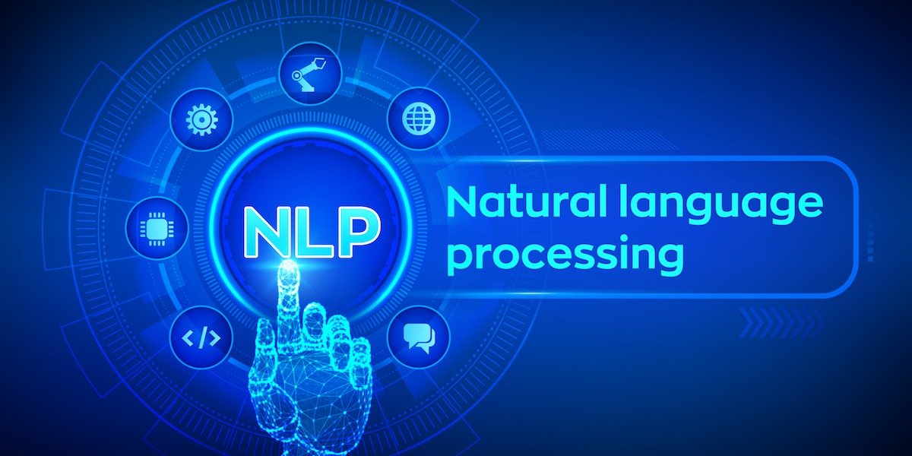

What we aim to do
Notes:
Data collection mention here
2-6 - #1

Slide 6
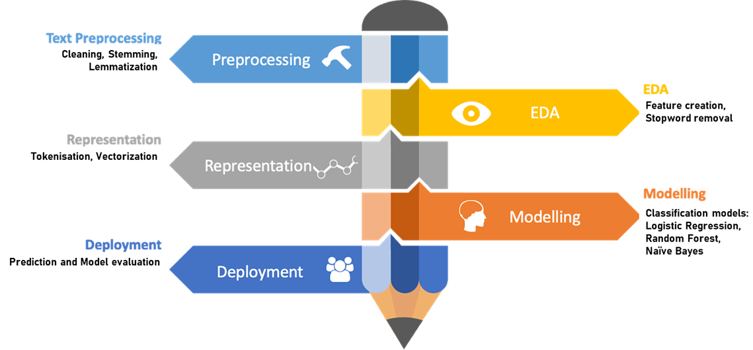
THE DATA SCIENCE PROCESS
Notes:
Pre-processing and EDA tgt
Representation -> Vectorizer

Slide 7
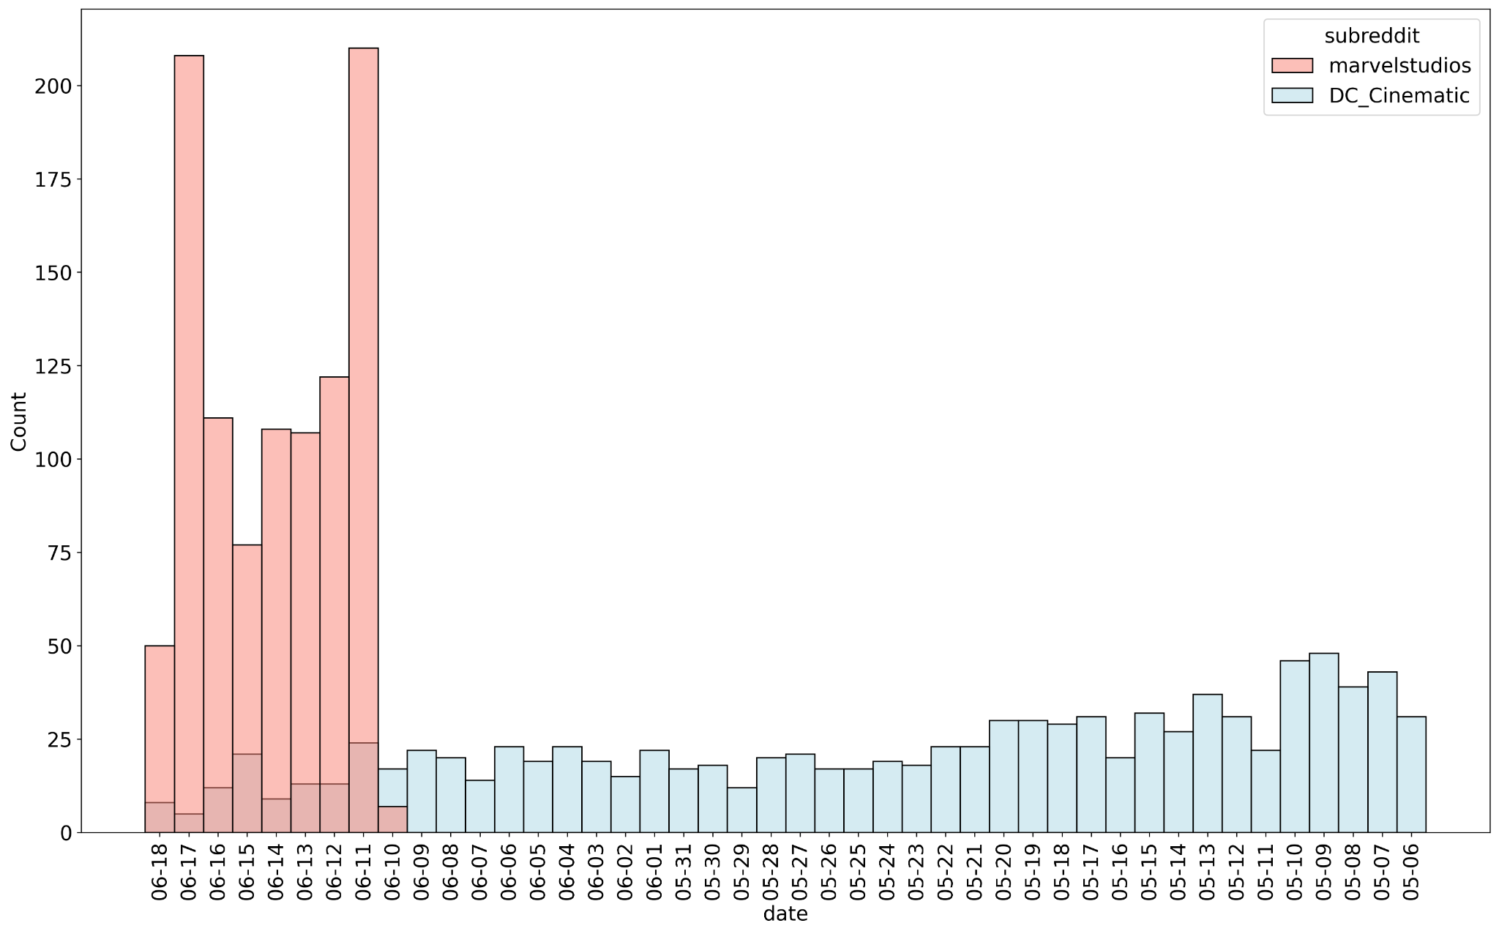
Distribution of 1000+ posts per subreddit OVER Time
Notes:
To change to horizontal bar (weihua)

Slide 8
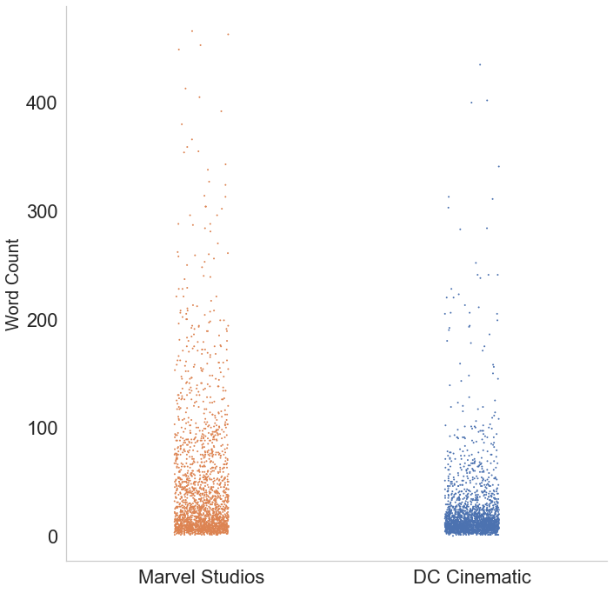
Distribution of Posts by Word count
Notes:
Supriya
Distribution of the word counts - make labels bigger, columns wider, change colours

Slide 9
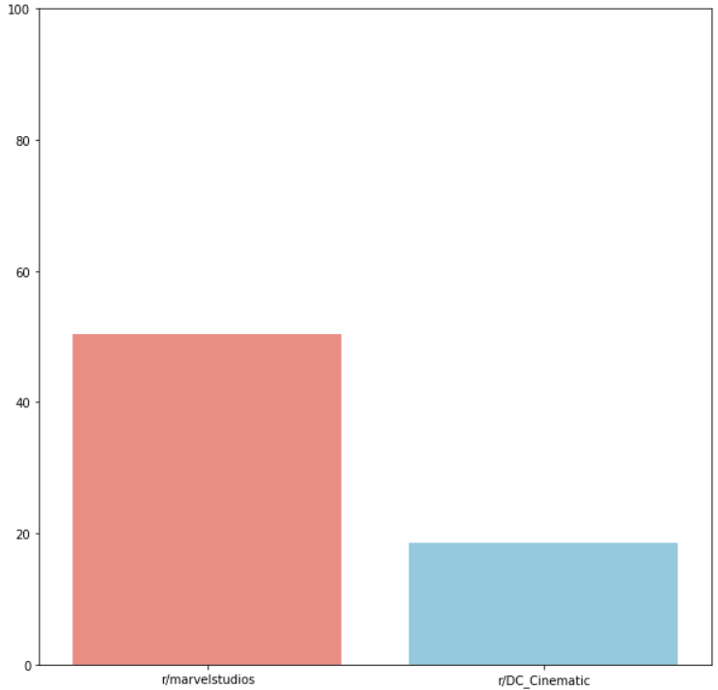
Percentage(%) of posts with Selftext
Notes:
From EDA - missing portion of selftexts -> why we combined title + text

Slide 10
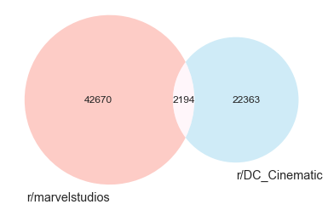
Words in post
Notes:
Daniel - peter give graph code to daniel
Good classification because small number of common words

Slide 11
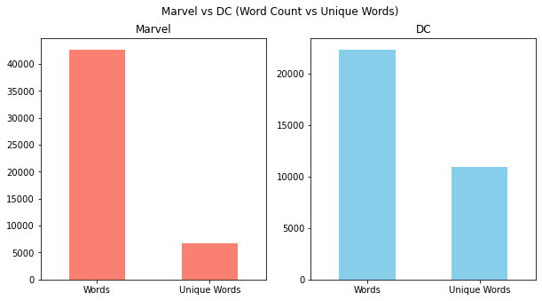
Marvel vs dc (Word count vs unique words)
Notes:
Daniel: Marvel on left

Slide 12
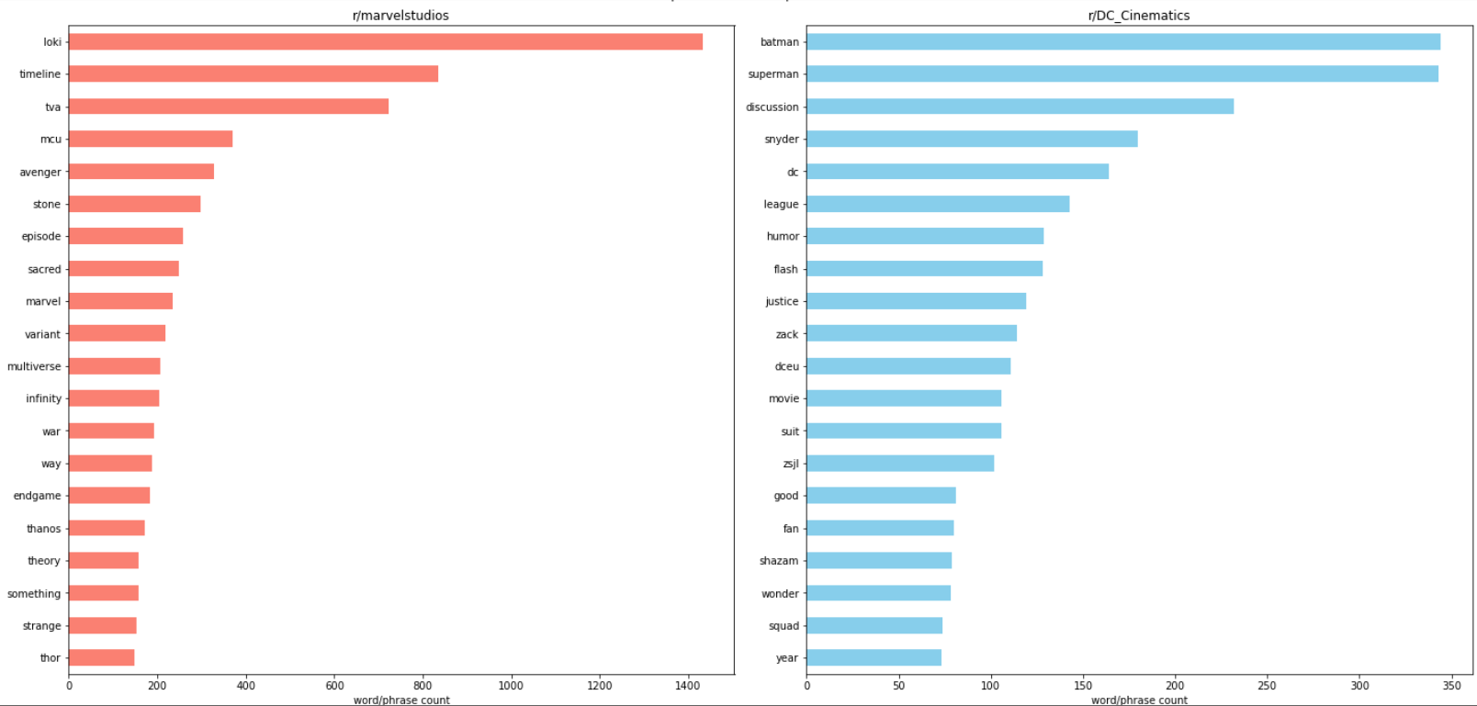
Top 20 single words
Notes:
Peter
1 ngram

Slide 13
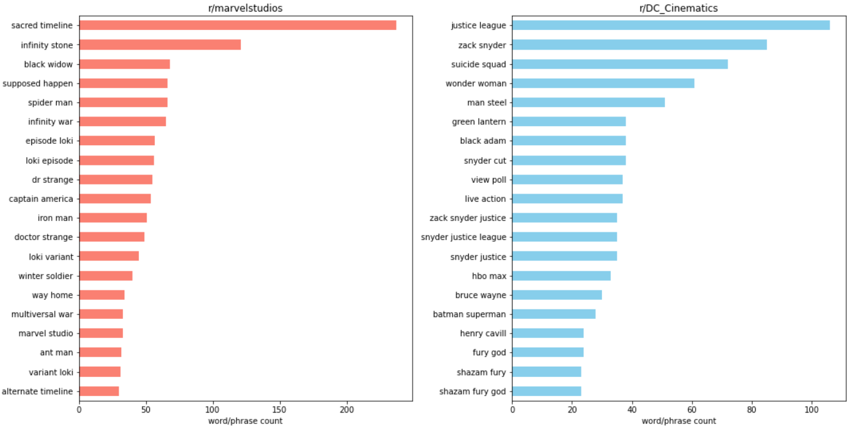
Top 20 combination of words
Notes:
Peter
2,3 ngrams

Slide 14
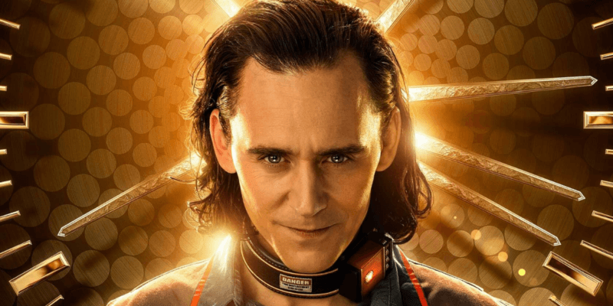

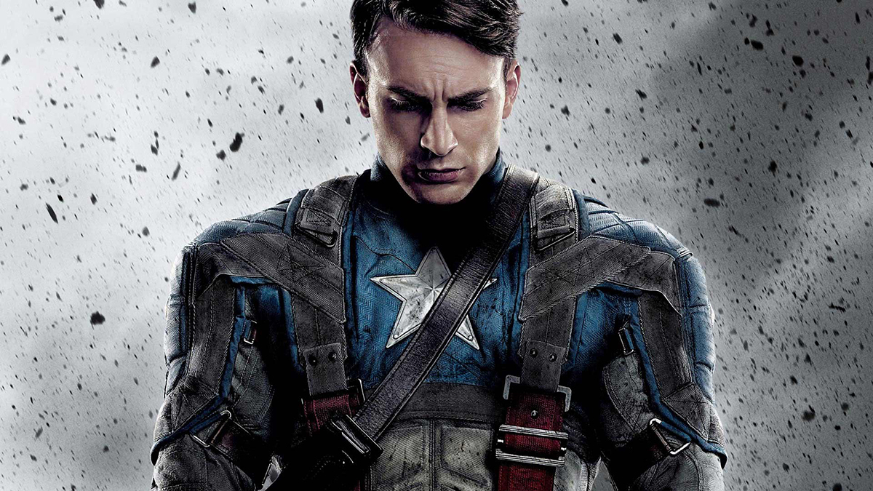
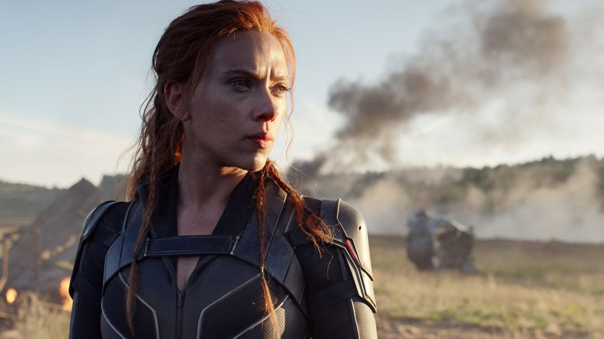
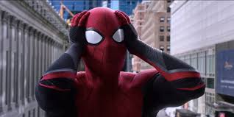
Marvel Top Words
Loki
Captain America
Black widow
Spiderman
Dr strange
Notes:
Peter

Slide 15
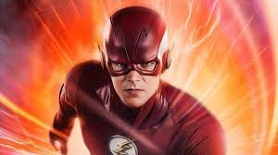
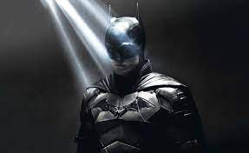
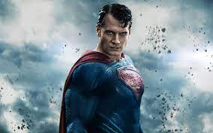
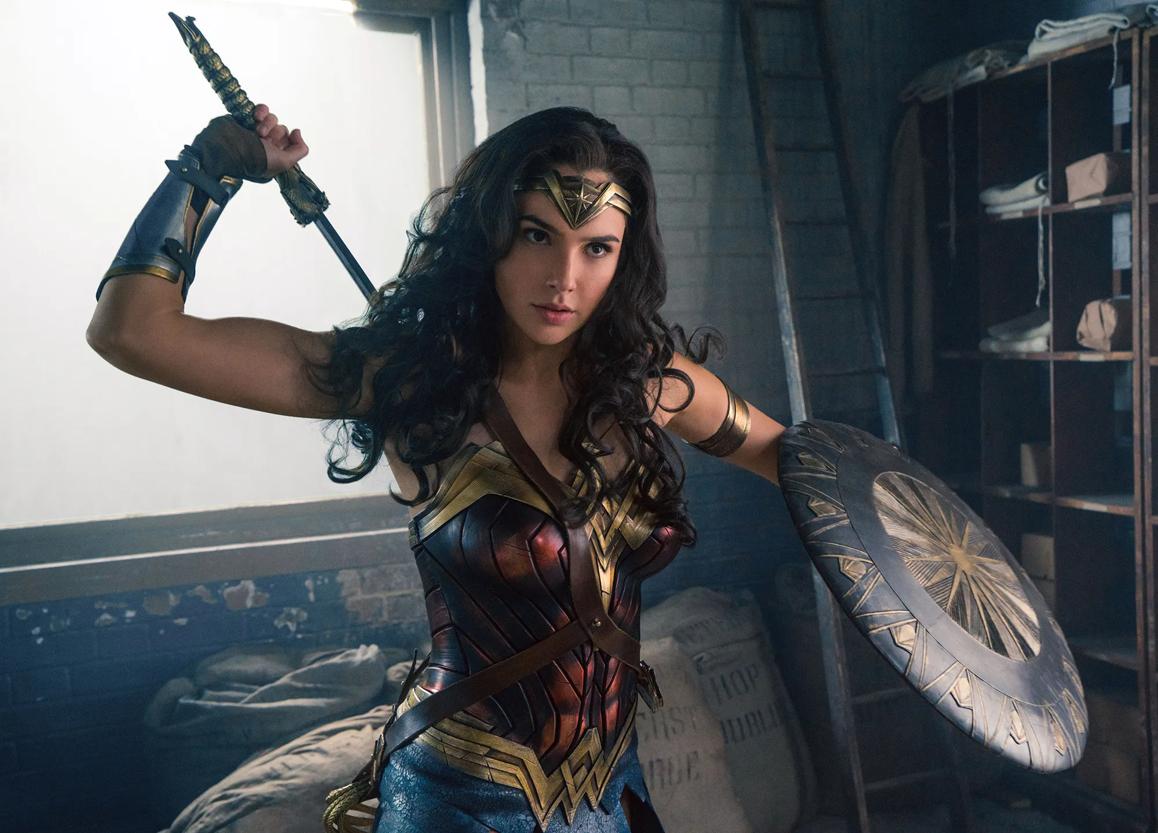
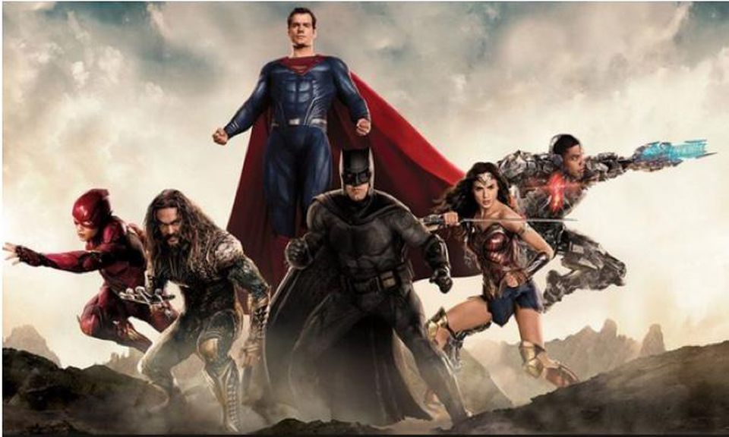
dc Top Words
Flash
Batman
superman
Wonder woman
Black widow
Justice league
Notes:
Peter

Slide 16
Modelling
Data Collection, Pre-processing & EDA
GridSearch
CountVectorizer
1. N_gram : (1,1)
2. max_features : 5000
TF-IDF Vectorizer
1. N_gram : (1,1)
2. max_features : 5000
Random Forest Classifier
Hyperparameters:
Max depth
n_estimator
Logistic Regression
Hyperparameters:
Solver : Liblinear
C : 1.0
L1_ratio : 0
Multinomial Naives Bayes
Hyperparameters:
Alpha
Best Choice by GridSearch
Notes:
Multinomial Naives Bayes: https://stackoverflow.com/questions/33830959/multinomial-naive-bayes-parameter-alpha-setting-scikit-learn

Slide 17
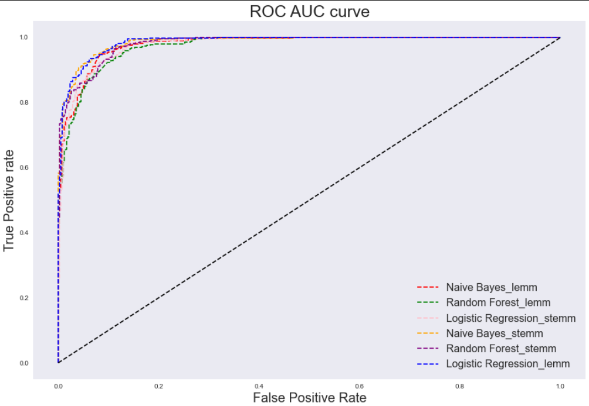
Metrics
Parameters | Results
Vectorizer | Tfidf Vectorizer
Model | LogisticRegression
Train AUC Score | 0.999
Test AUC Score | 0.993
Model Train Accuracy | 0.990
Model Test Accuracy | 0.959
Accuracy train test,
ROC train test
Notes:
To change colour for the confusion matrix (weihua)
Peter to update with log reg curve and bigger fonts
Format slides

Slide 18
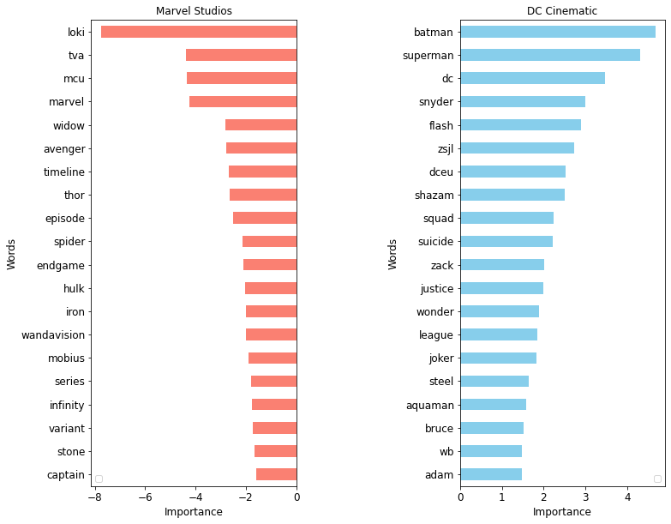
Model Evaluation - Top Predictors
Notes:
Supriya: Increase font size
These are the top predictors that help our model predicts - verification that our model is working well.

Slide 19


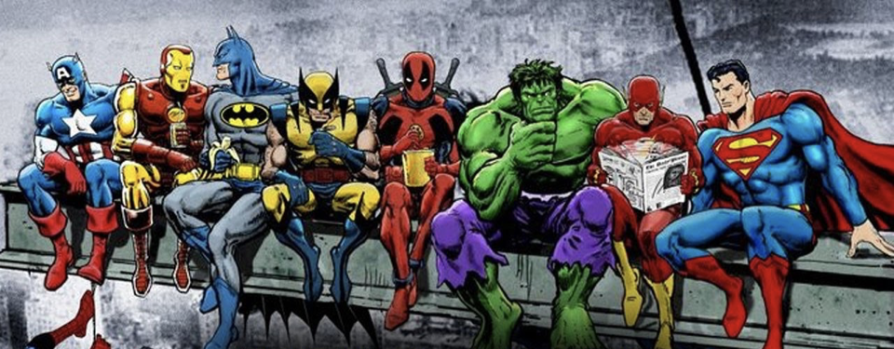
Conclusion
Identify Marvel and DC fans on reddit for targeted advertising of the client’s new superhero game
Our model is trained on reddit posts and can classify posts as Marvel or DC with 96% accuracy.
Notes:
Need to tally the accuracy score
Supriya: Change bubble background to white.
Client should display advertisements promoting their game, by using characters from Marvel and DC to the respective users

Slide 20



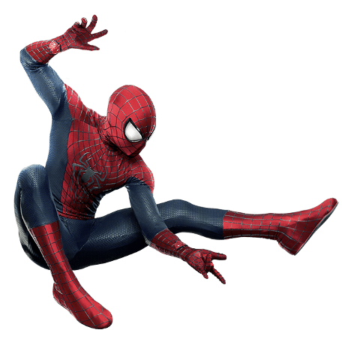
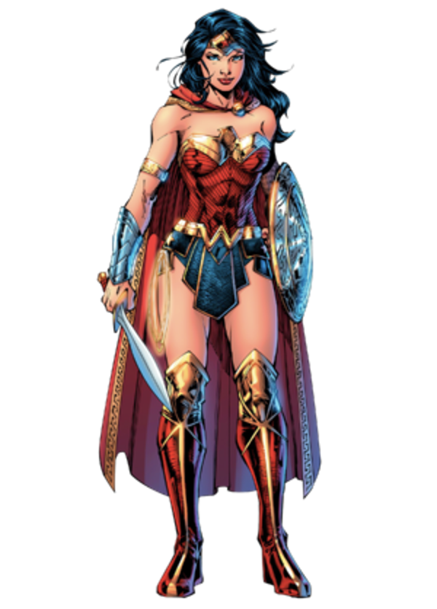
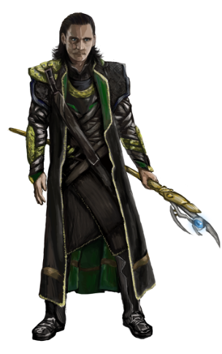
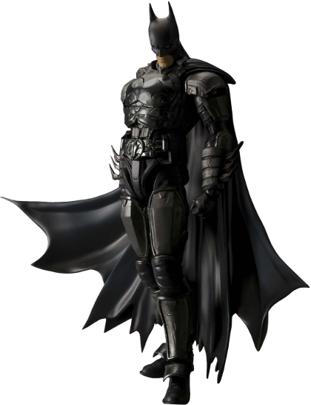
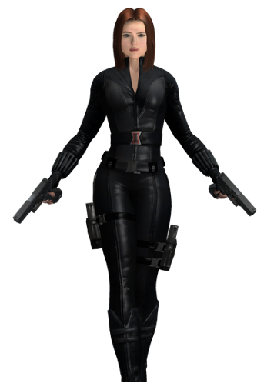
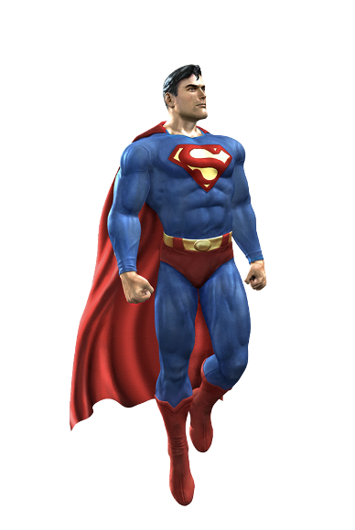
Conclusion
The coolest superheroes recommended for the game!!
Spiderman
Batman
Wonder Woman
Loki
Black Widow
Superman
Notes:
Supriya: Complete the slide
Our analysis of most recent posts, shows that following characters are the most talked about, client should incorporate these heroes into their games.
Marvel: Loki, Captain America, Black Widow, Dr Strange Spiderman
DC: Batman, Superman, Black Adam, Justice League, Wonder Woman

Slide 21
Limitations and Recommendations
Limitations
Model limited to Reddit data
Data was limited to 1000+ posts per subreddit
Sentiment analysis on posts
Recommendations
Retraining of models every 2 months (or at every product release)
Expand into other social media platforms
Notes:
Future steps
Recommended to retrain model should there be a need to perform future classifications of subreddit users again to ensure model is up-to-date with latest trend words etc.
Sentiment analysis to determine the sentiment of posts which would be able to give us a more accurate idea of the popularity of the various superheroes.
Expand into other social media platforms for advertising and for data collection

Slide 22
Thank you!
Notes:
Future steps
Recommended to retrain model should there be a need to perform future classifications of subreddit users again to ensure model is up-to-date with latest trend words etc.
Sentiment analysis to determine the sentiment of posts which would be able to give us a more accurate idea of the popularity of the various superheroes.
Expand into other social media platforms for advertising and for data collection

